Slide 1


Controllable Hexapod Robot
CIULEI DANIEL
Electrical engineering department
02

Slide 2
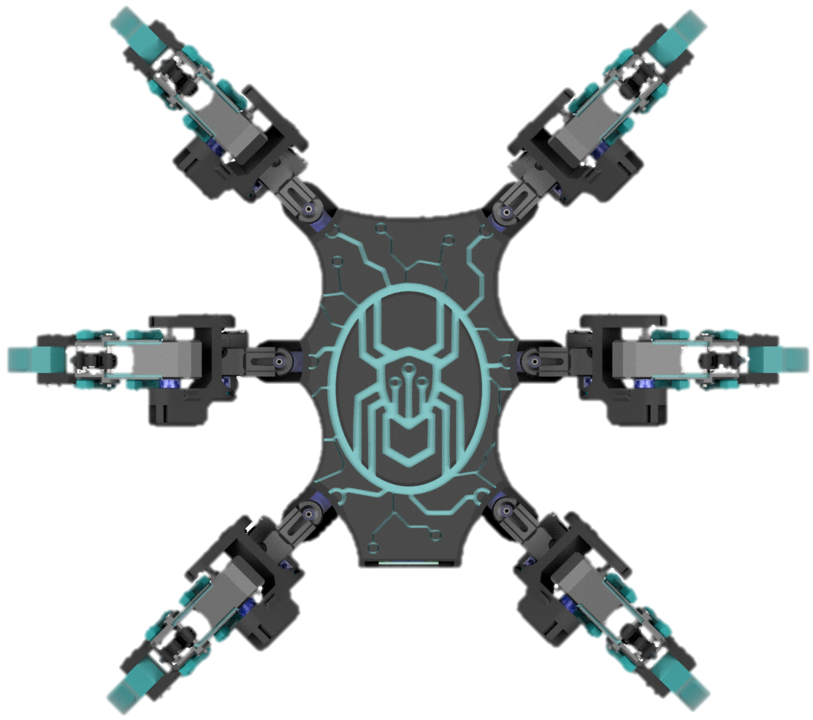
Objectives
Topics covered
To create a proof of concept, a viable solution for a six-legged robot
Model a Hexapod with multiple DoF
Create a motherboard and hardware plan for the robot
Design software architecture: firmware (MCU), communication network, Android application
Hexapod architecture
CAD design
Hardware design
Kinematics and gait analysis
Software design
Results
Future development possibilities

Slide 3



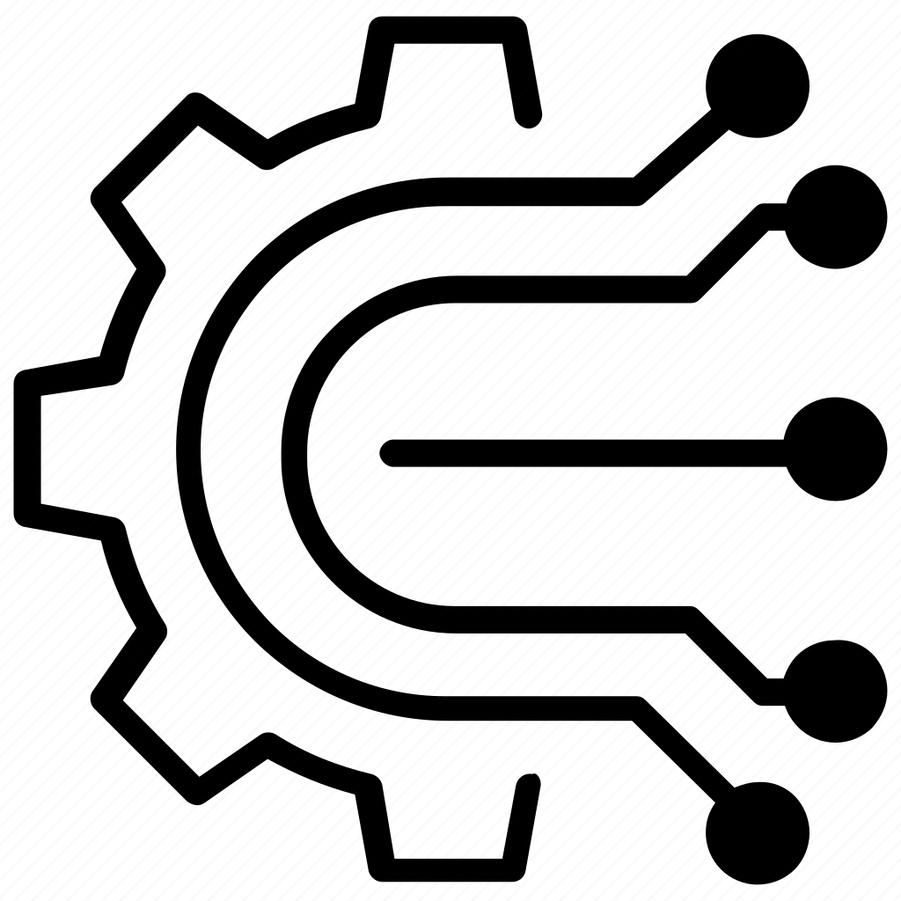
User
IoT Protocol
The one who is controlling the robot through an Android smartphone that runs the Hexapod Control application.
A Raspberry Pi single-board computer that runs a MQTT Broker the Hexapod’s MCU can communicate with the Android application.
component 01
component 02
Architecture of the Hexapod
From a top-level view of the system, the architecture of the Hexapod can be broken down into 3 distinct components.
Robot
Incorporates all the mechanical, electromechanical and hardware parts of the robot as well as the firmware that will run on the MCU.
component 03

Slide 4









User
Architecture of the Hexapod
Smart Phone
Android app
IoT Protocol
Raspberry Pi
Mosquitto Broker
Robot
Firmware
Hardware

Slide 5
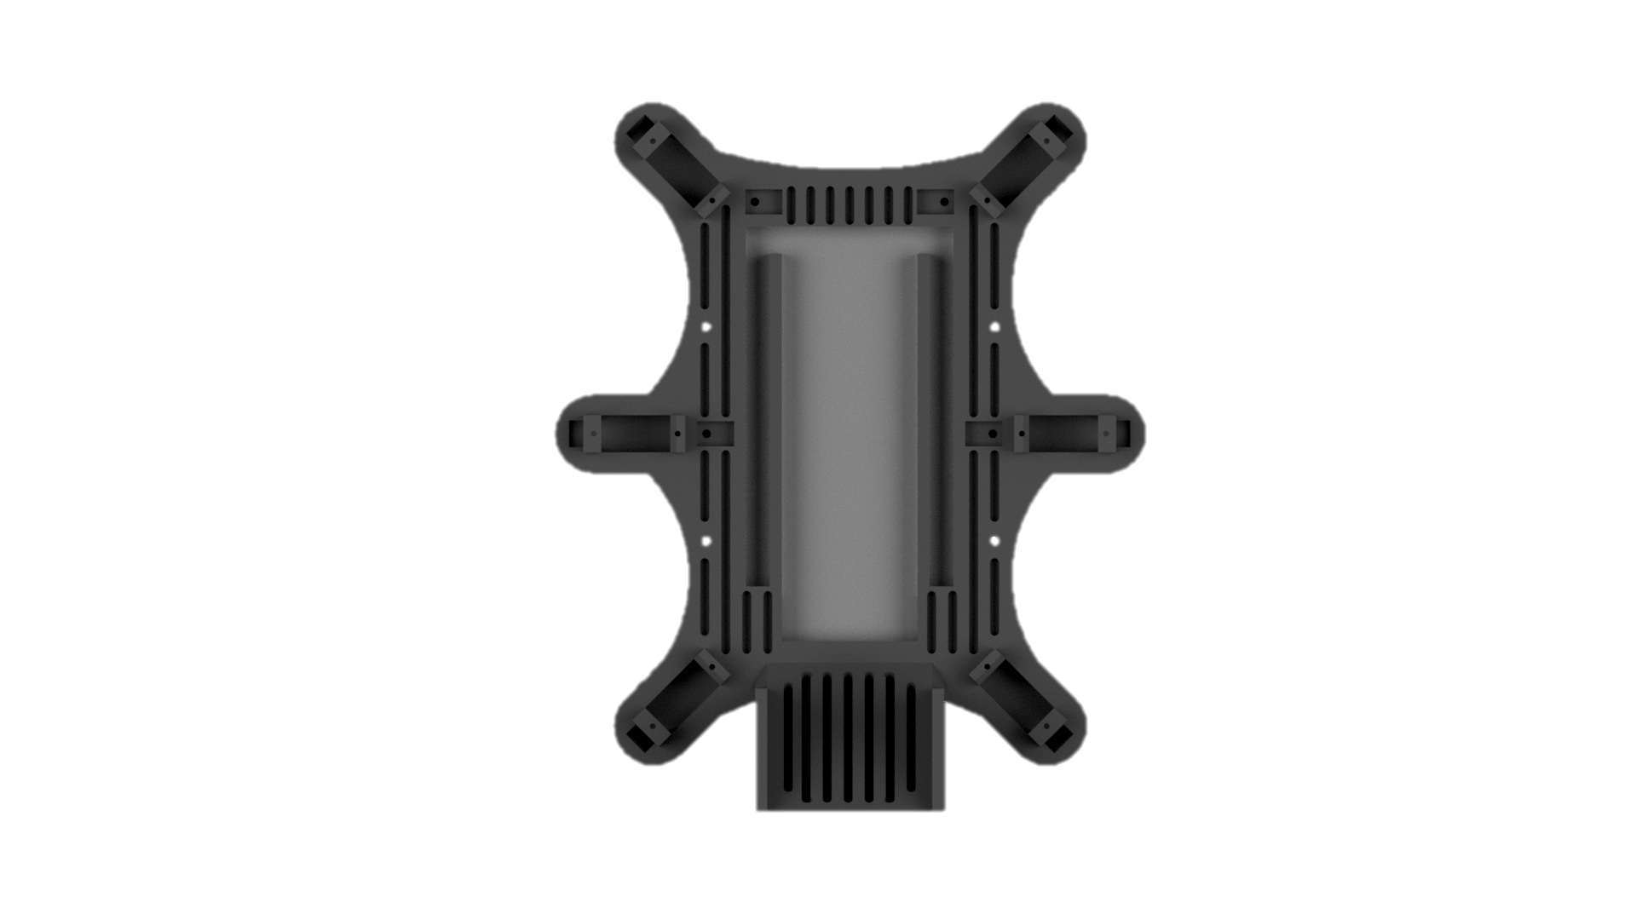
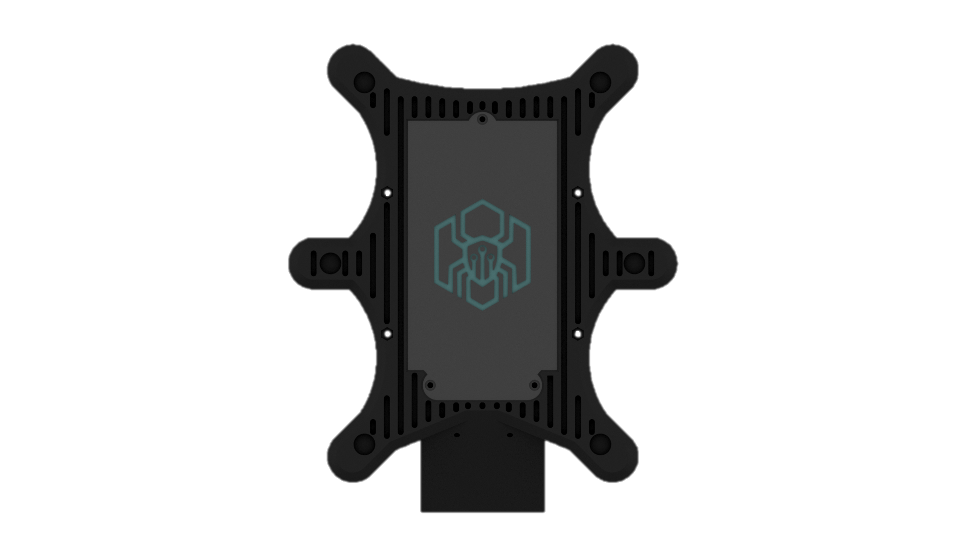

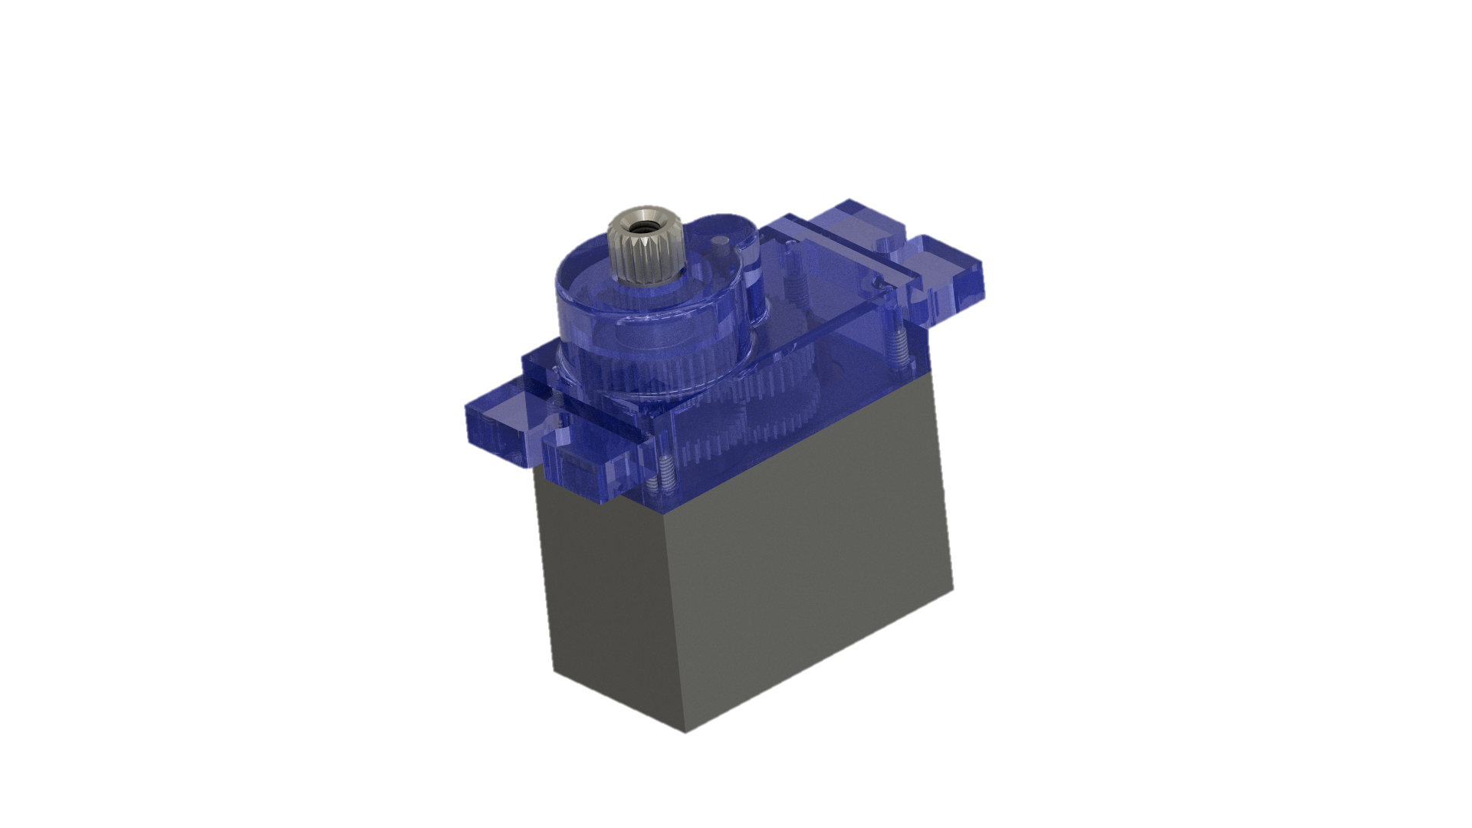
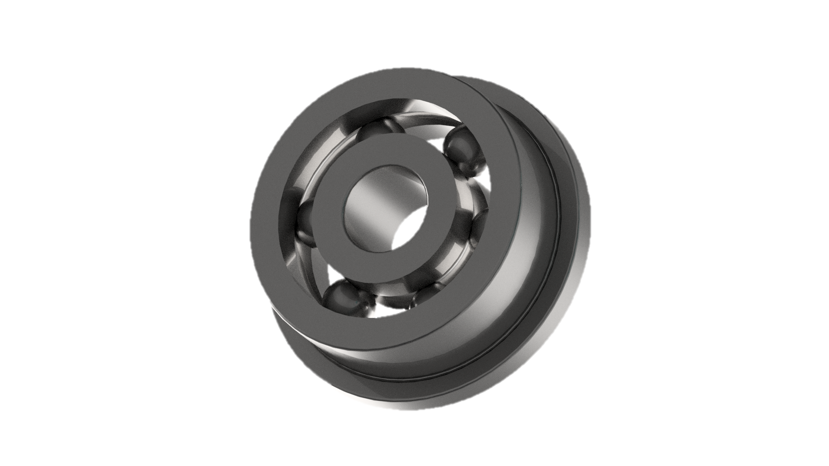
Chassis of the robot
The base frame resembles a somewhat distorted rectangle shape with cut corners. Four servomotors will be placed on these ends, and two more in the middle between the ends on the longer side of the frame for a balanced posture along with bearings beneath them.
Top view
Bot view

Slide 6

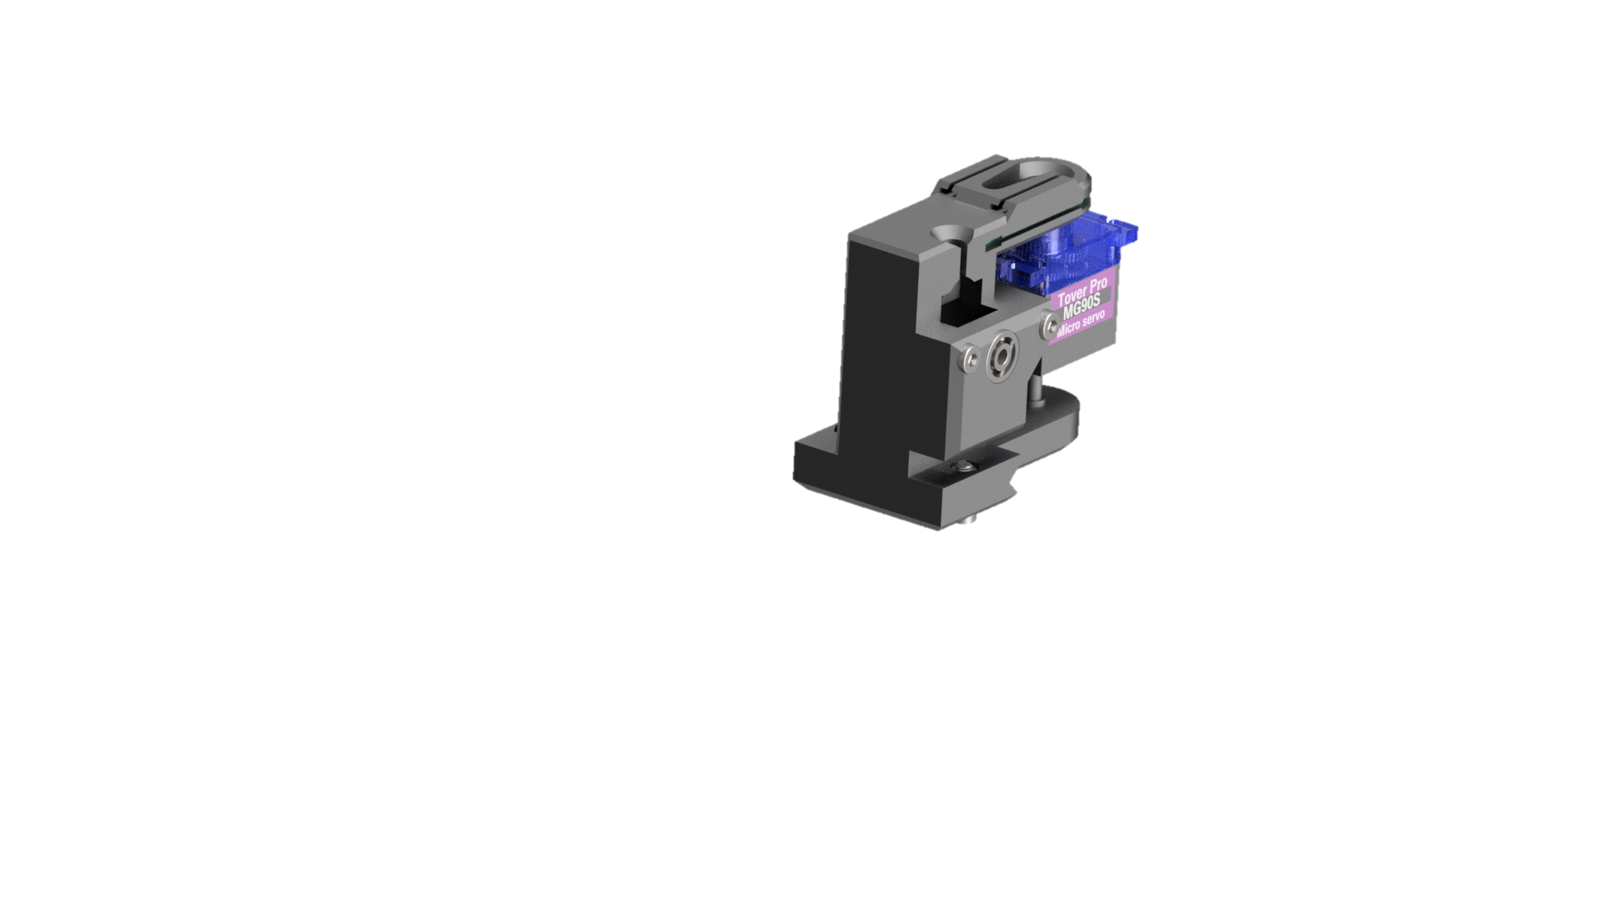
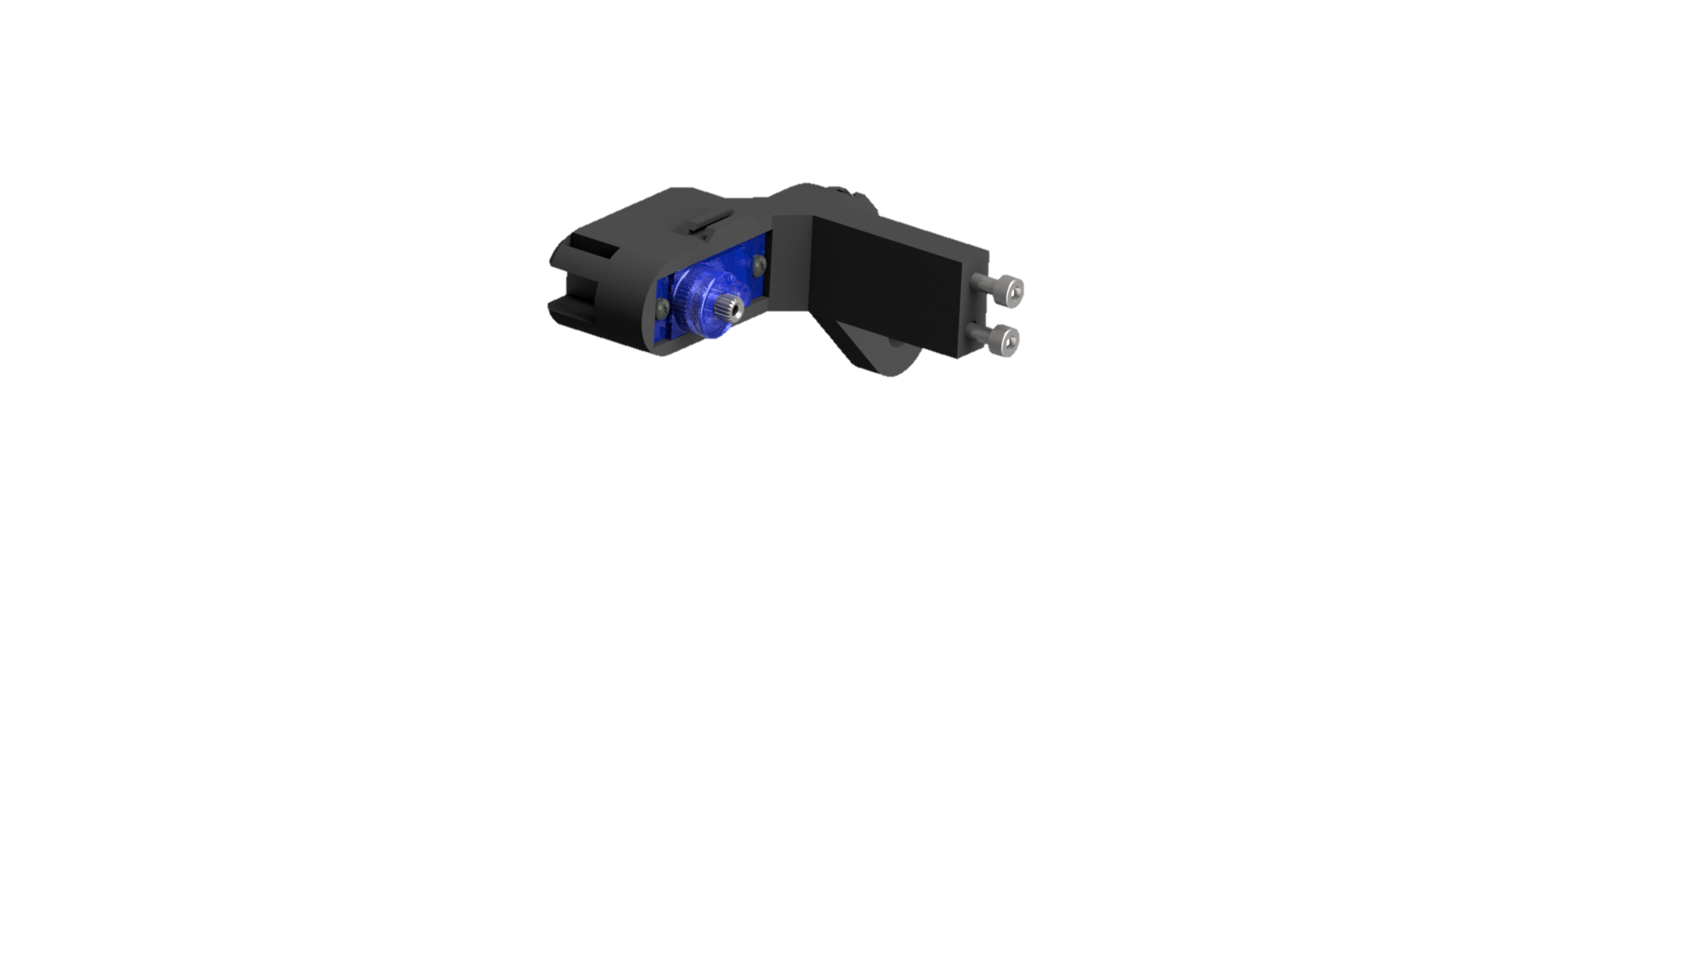
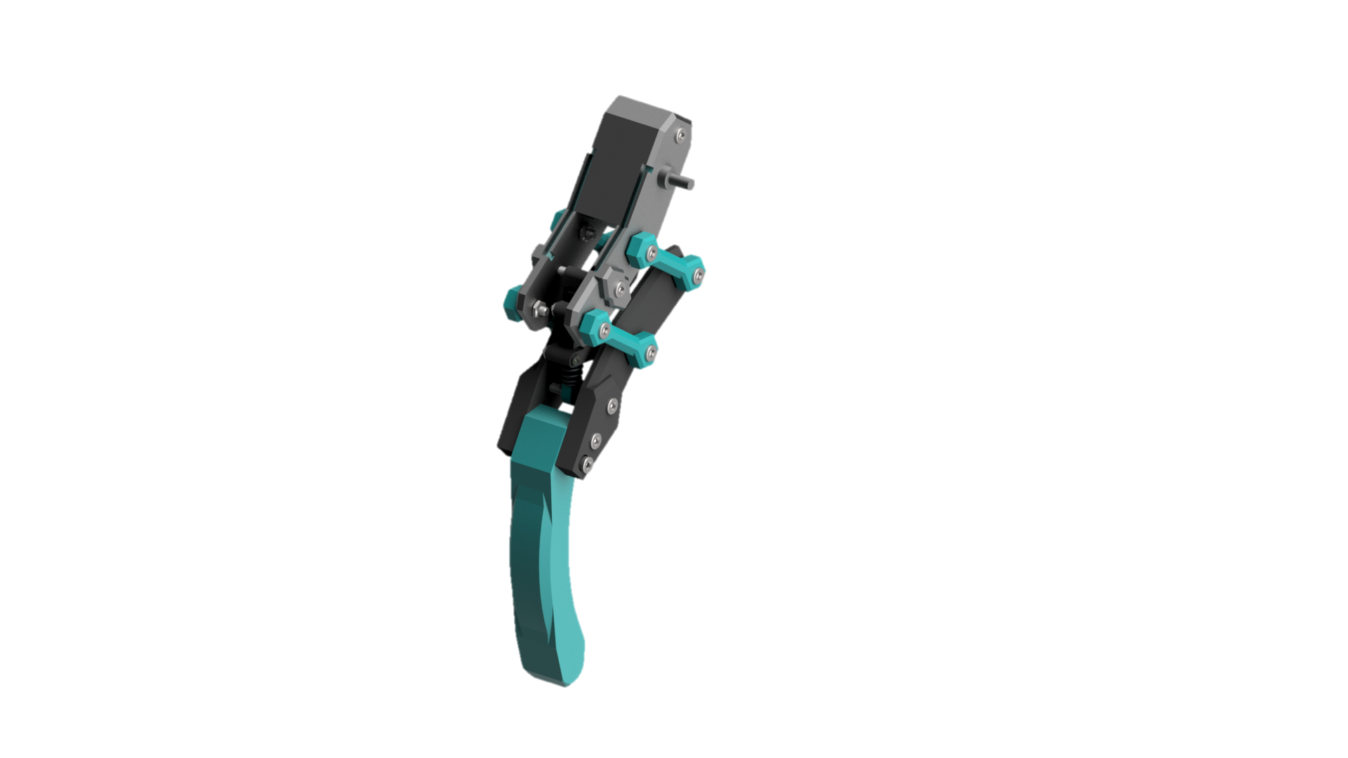
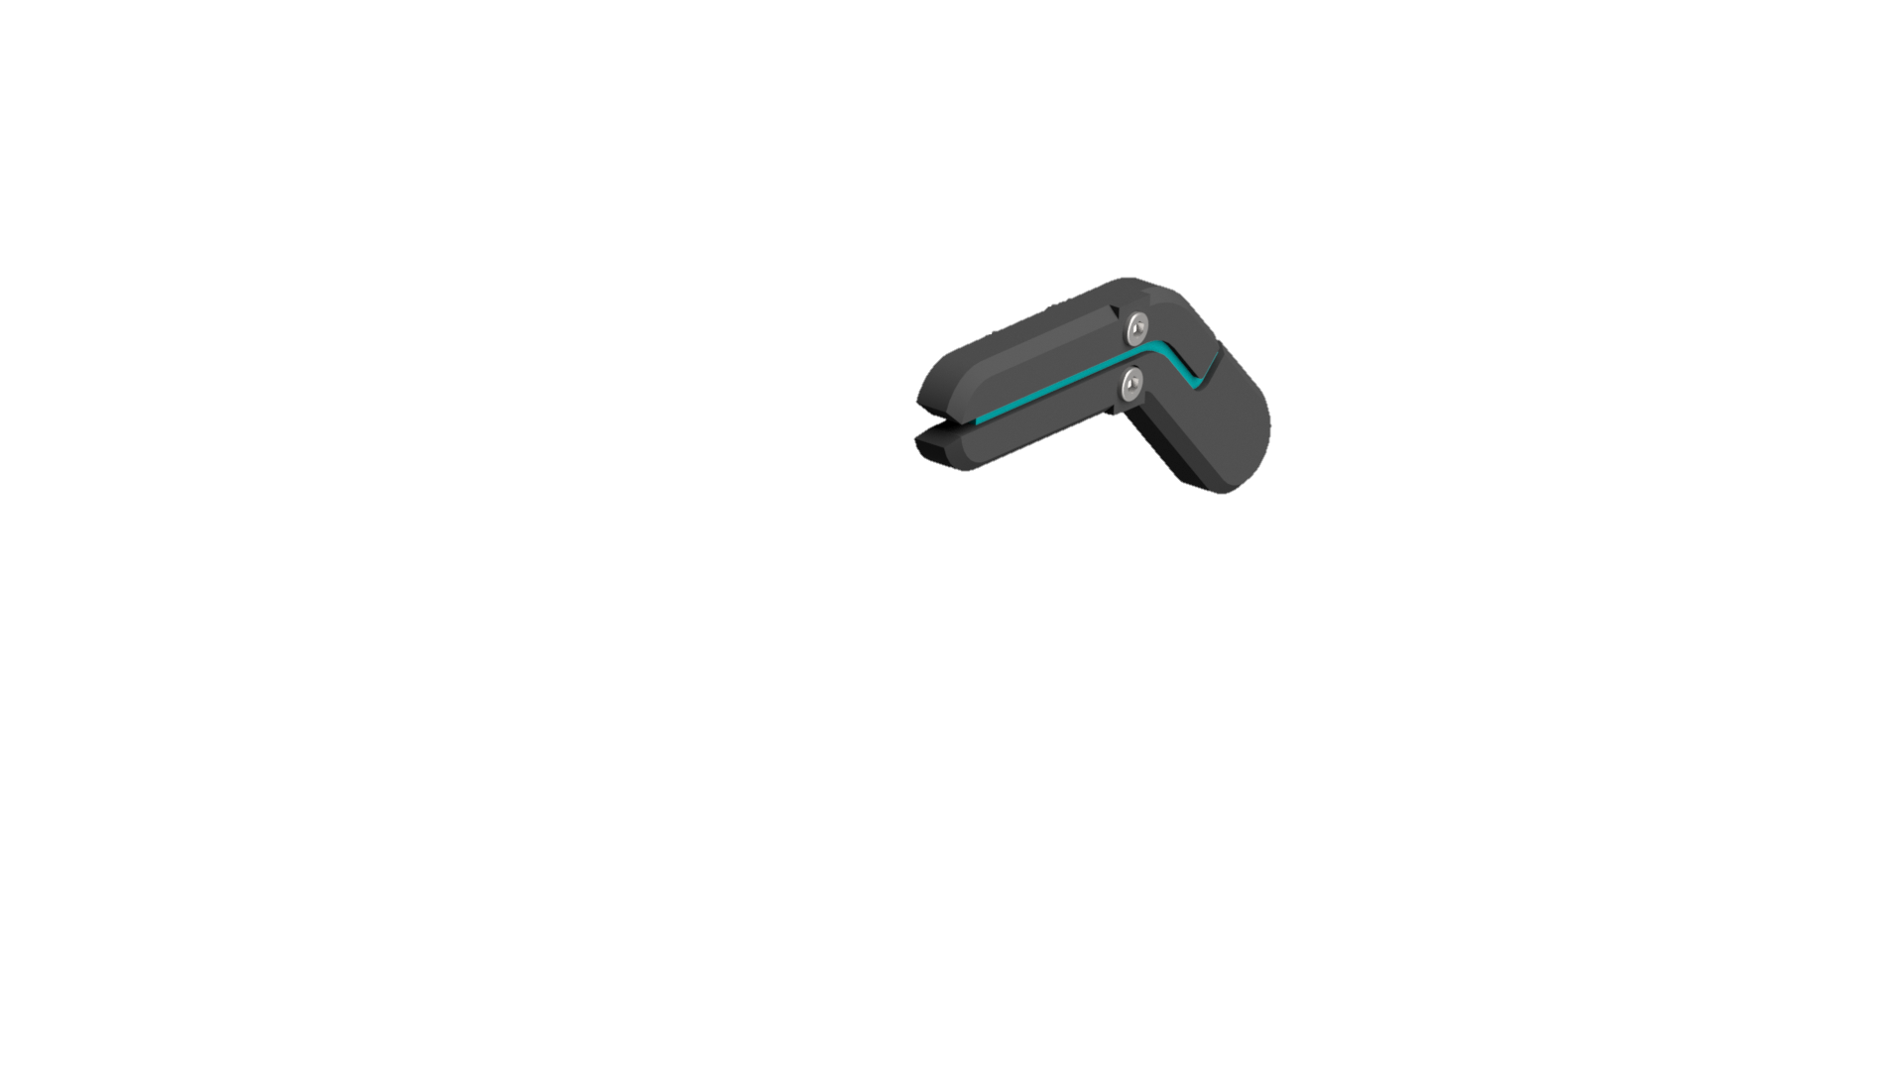
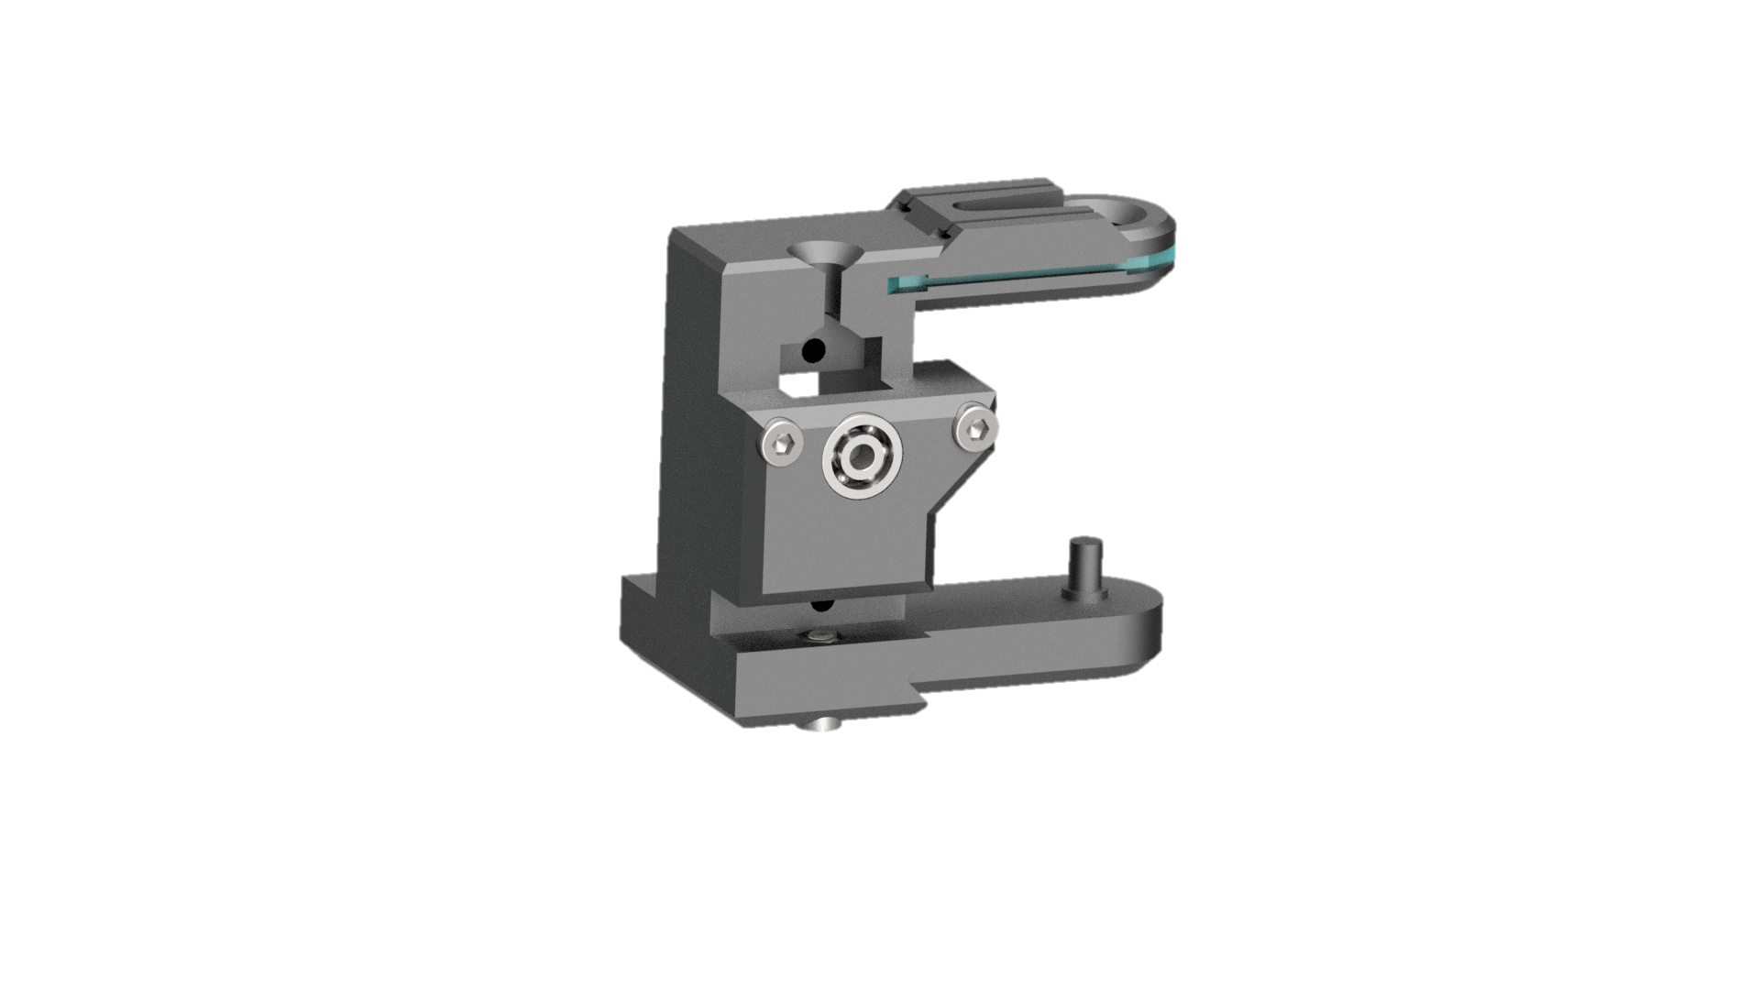
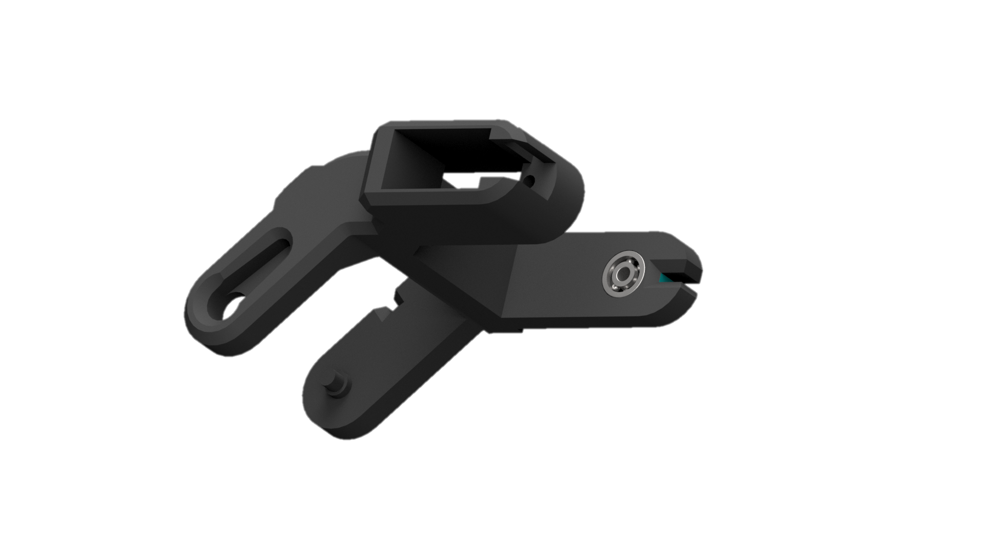
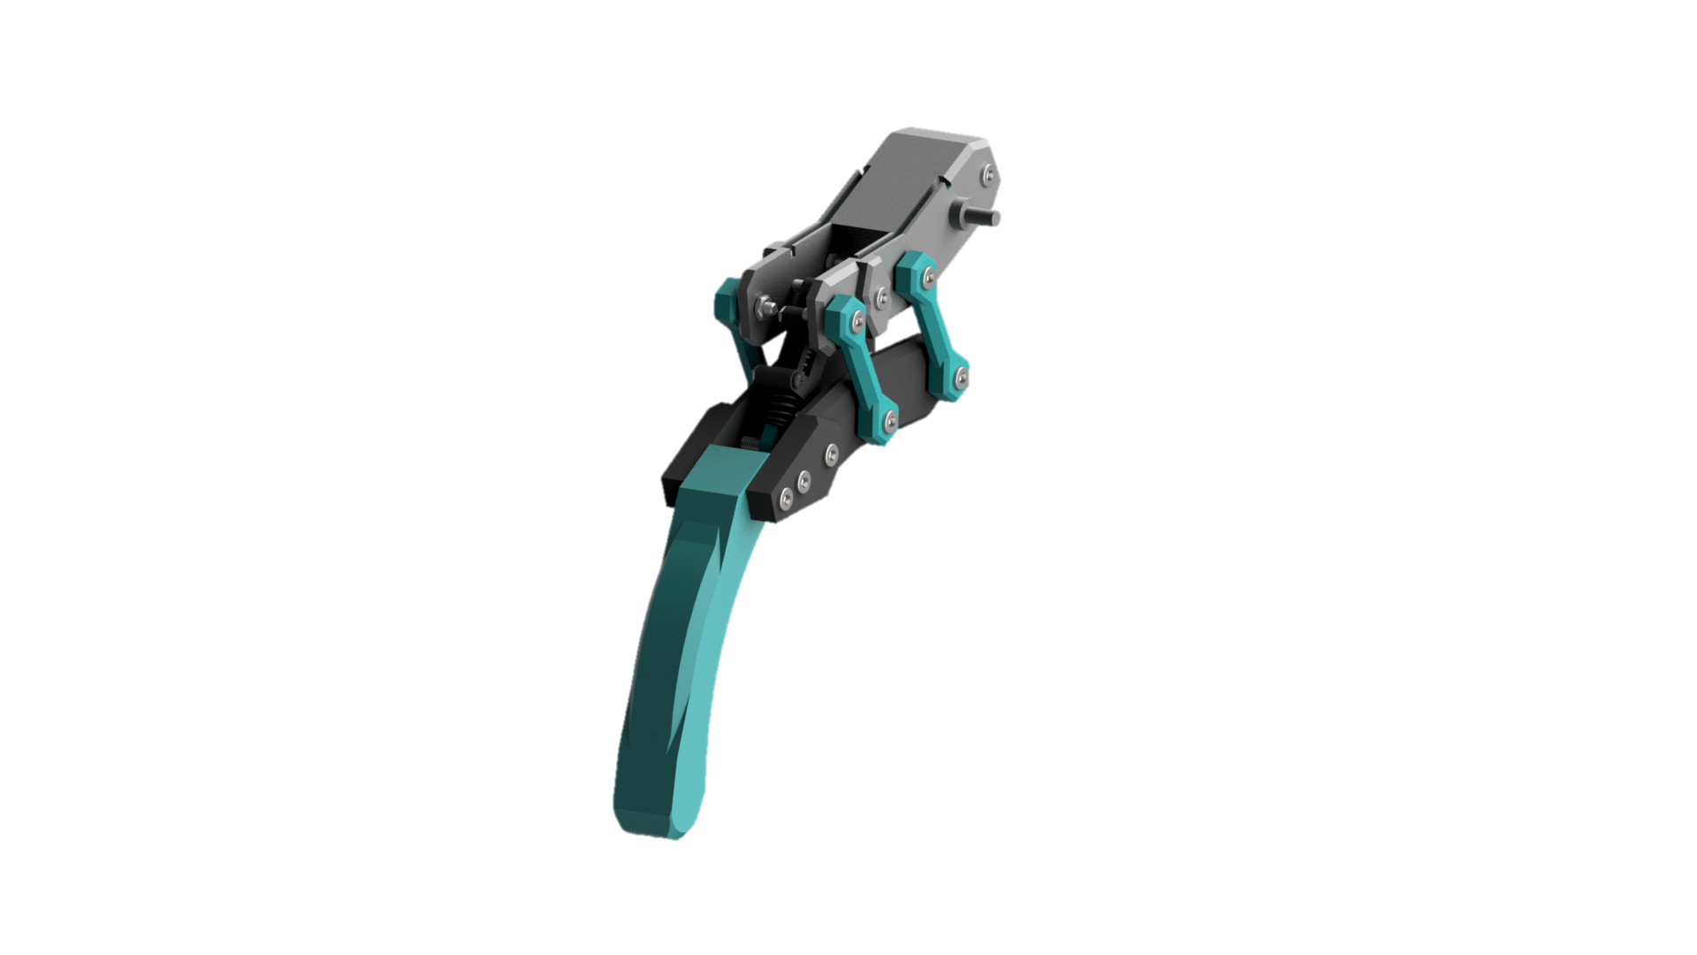
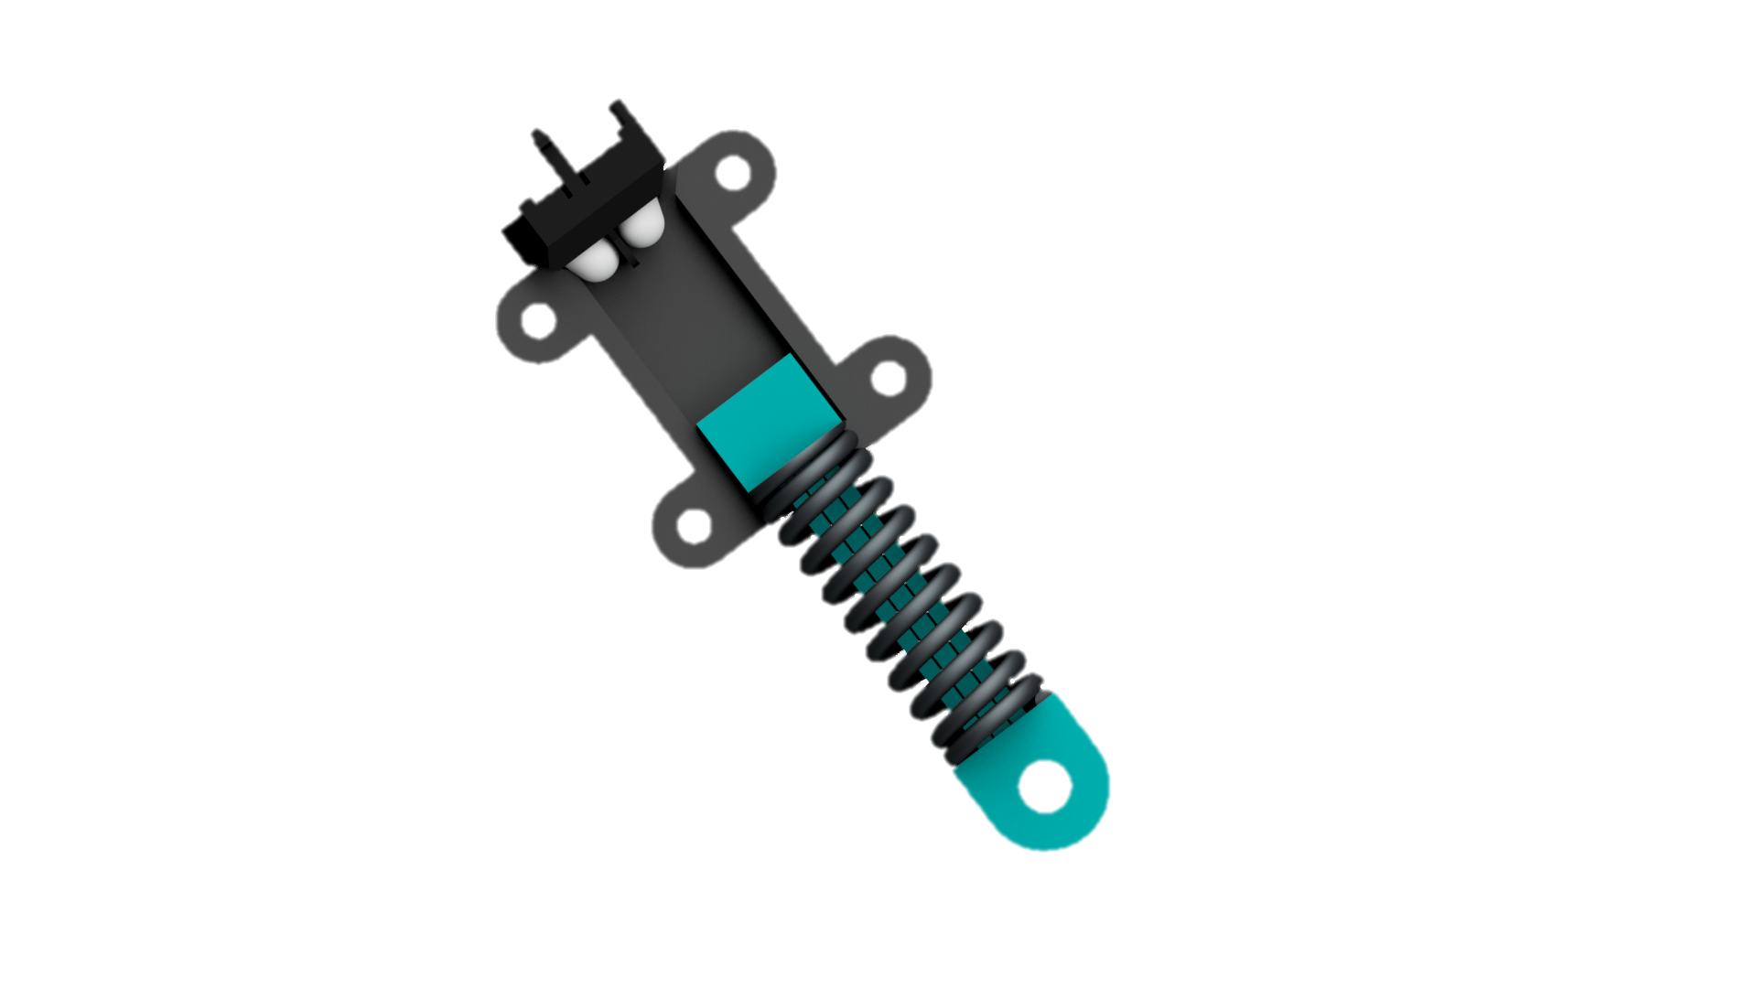
Leg design
An arachnid build with a telescopic leg design configured in an outward knee form.
Made of three sections, namely: coxa, femur and tarsus.
A piston mechanism with a spring attachment for shock absorption with an IR sensor to determine leg ground contact.

Slide 7
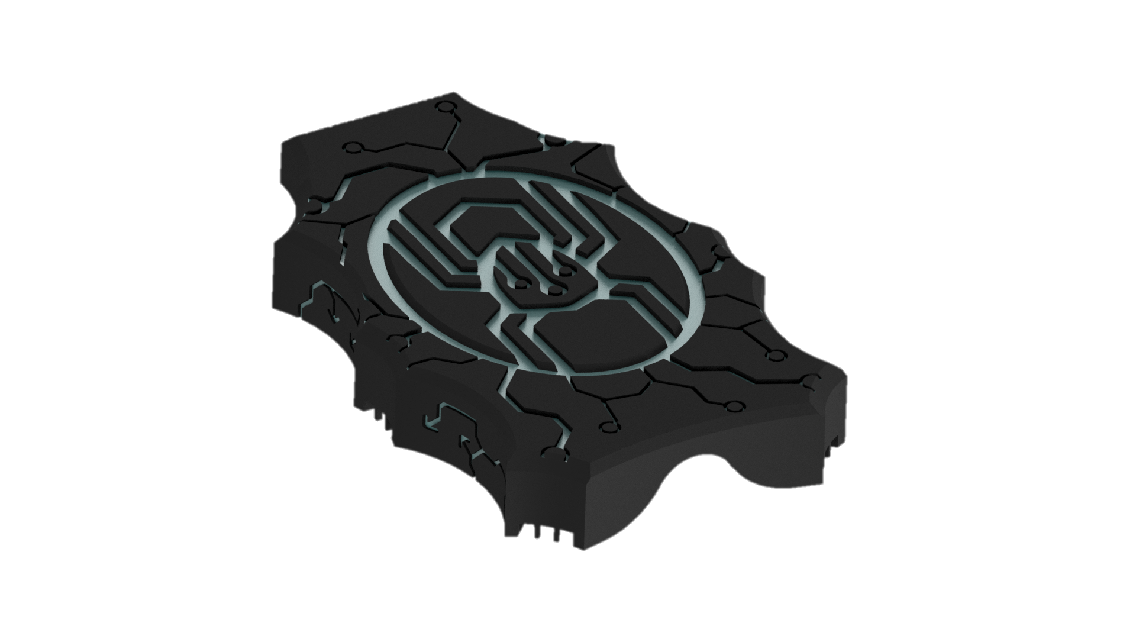
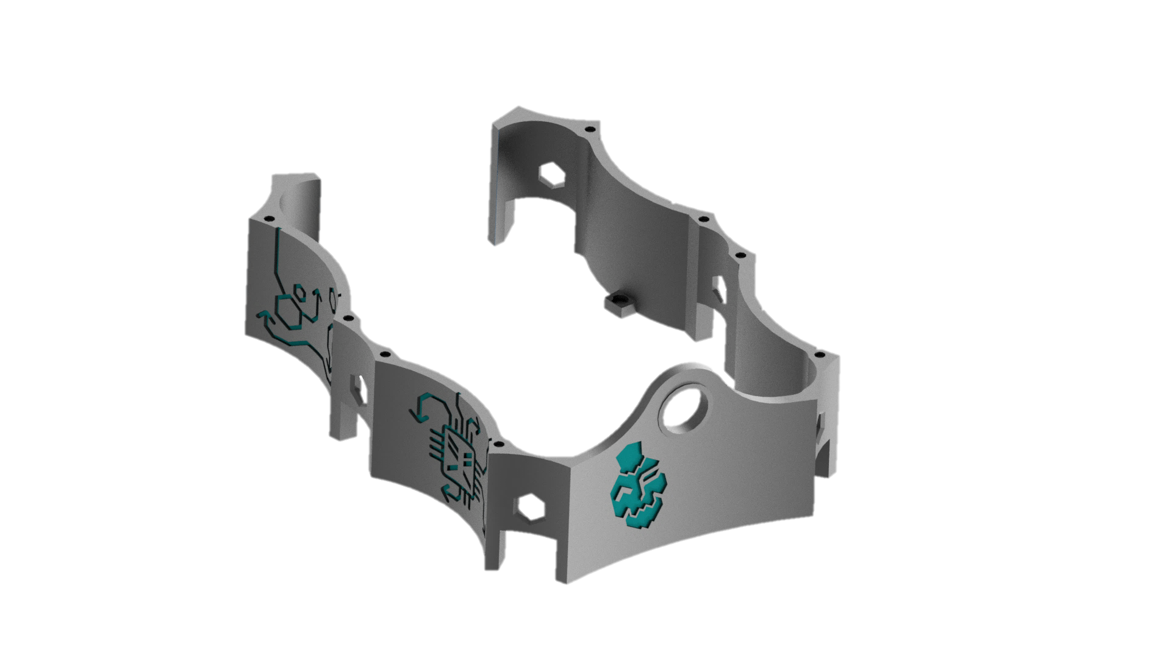
Protective Shell of the robot
The shell of the Hexapod is an optional component of the robot that should shield the hardware in from wear and tear. A hole is found on the front of the shell where a button can be later installed to powerup/shutdown the Hexapod.

Slide 8
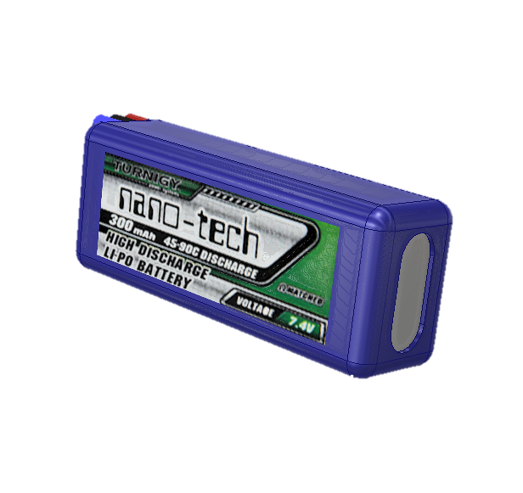
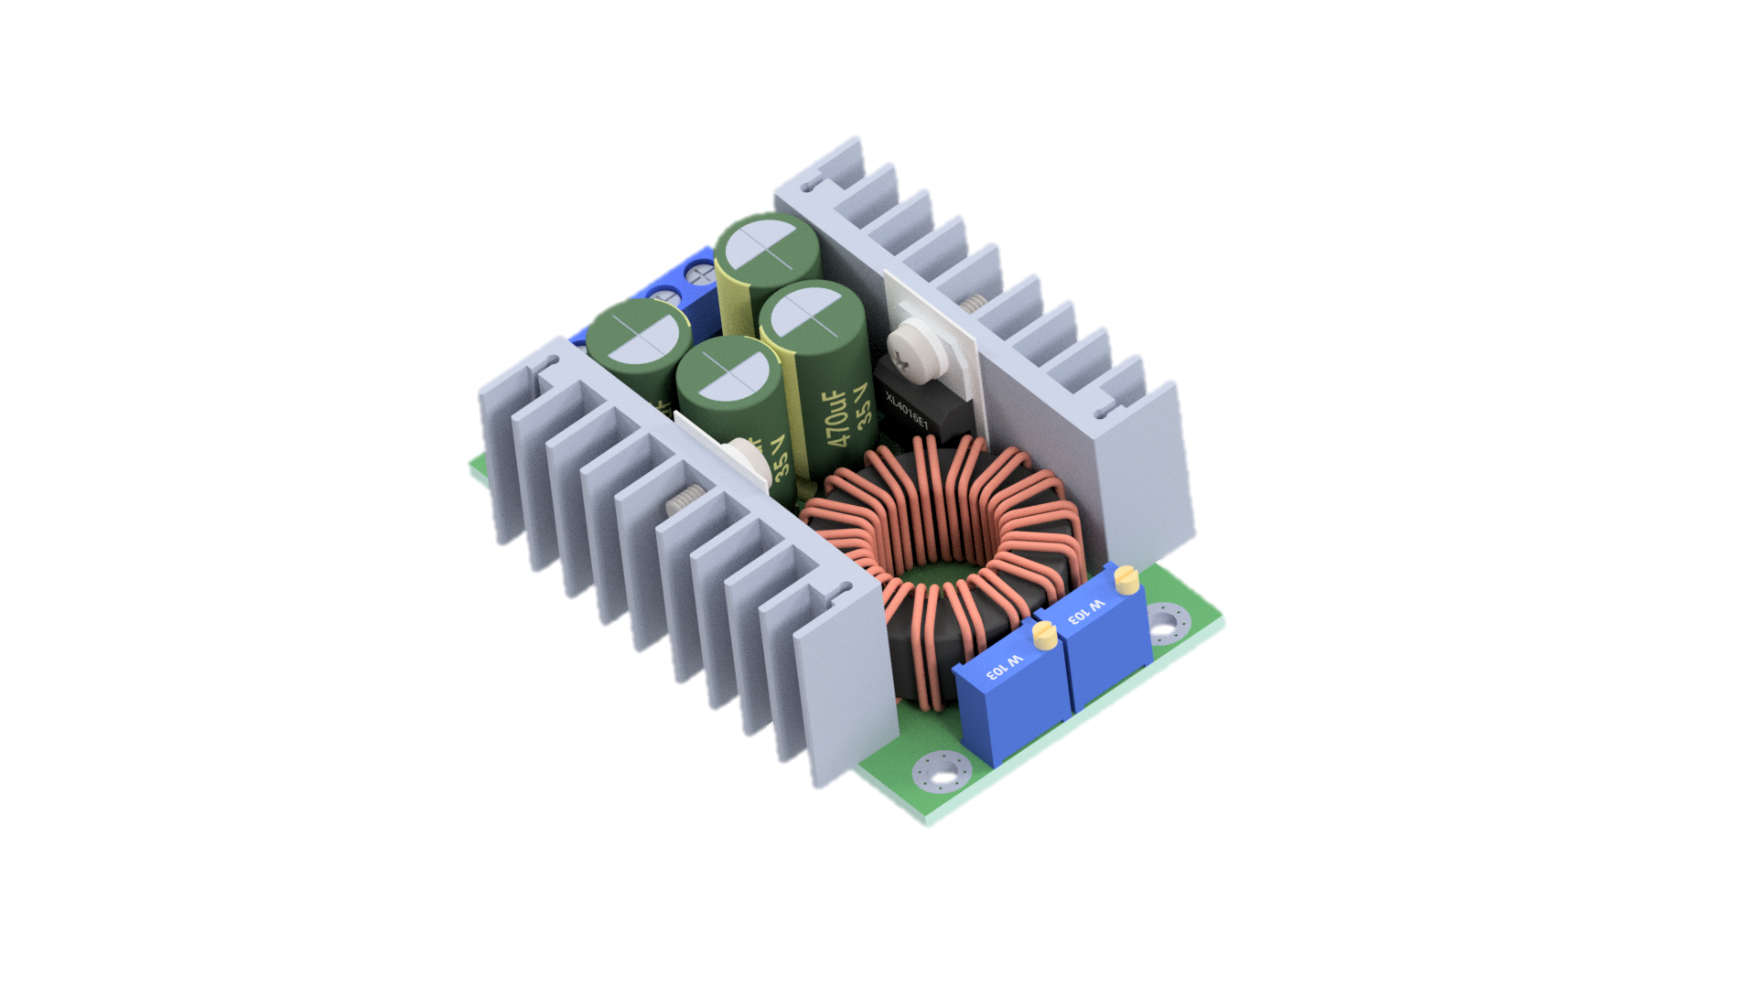




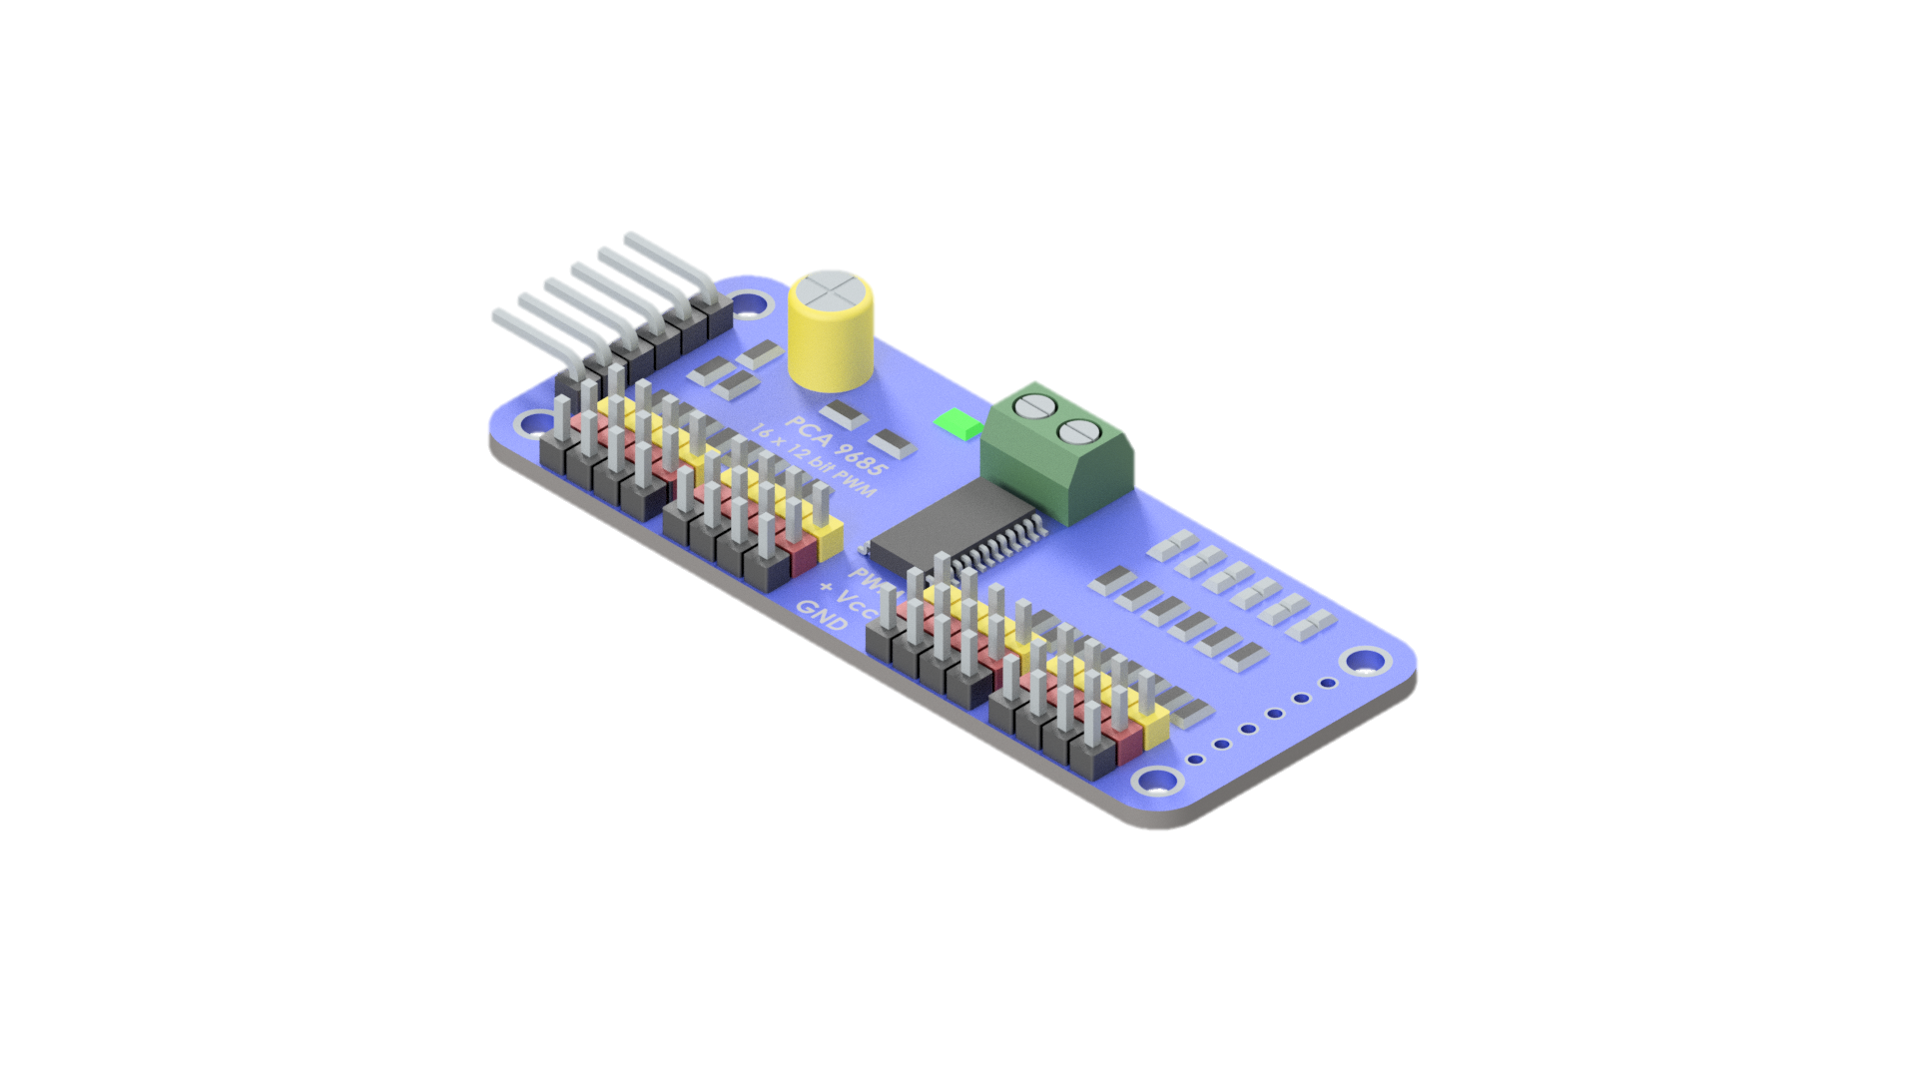
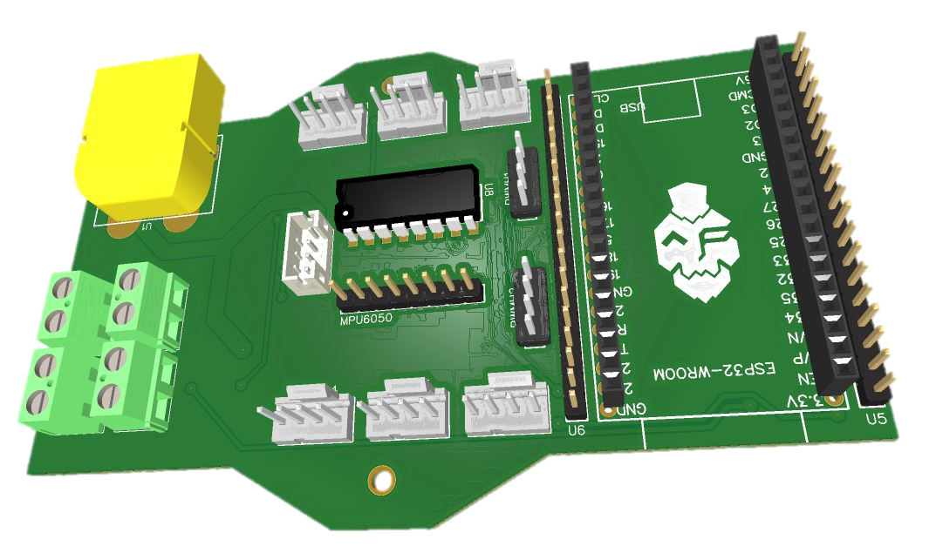
Electrical components of the Hexapod
LiPo 7.4V 3000mAh
XL4016 Buck Converter
The Hexapod carries a motherboard that incorporates the control unit.
External hardware is also required for the robot to function:
LiPo battery, Buck converter and two PWM drivers.
PCA9865 PWM Driver
Motherboard
2x

Slide 9

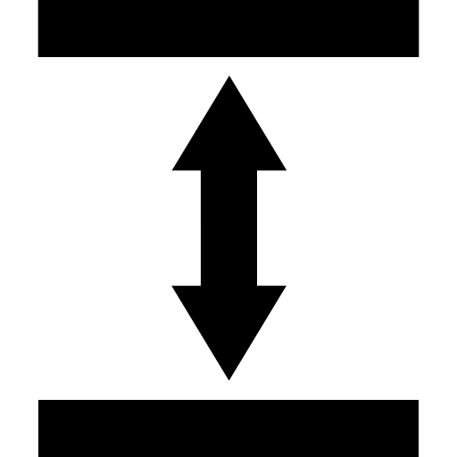
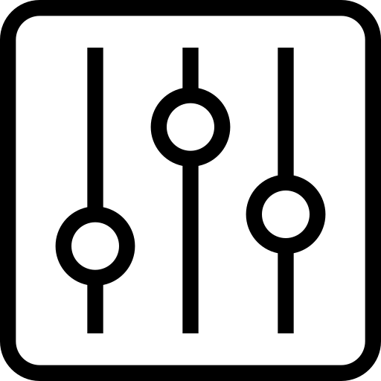
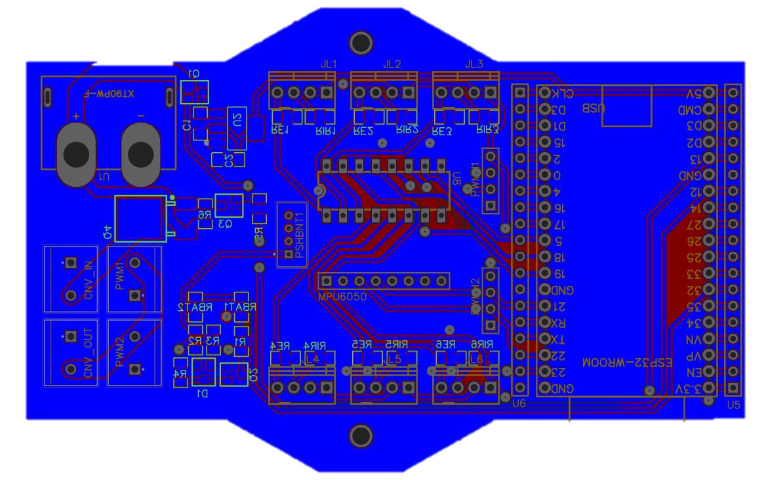
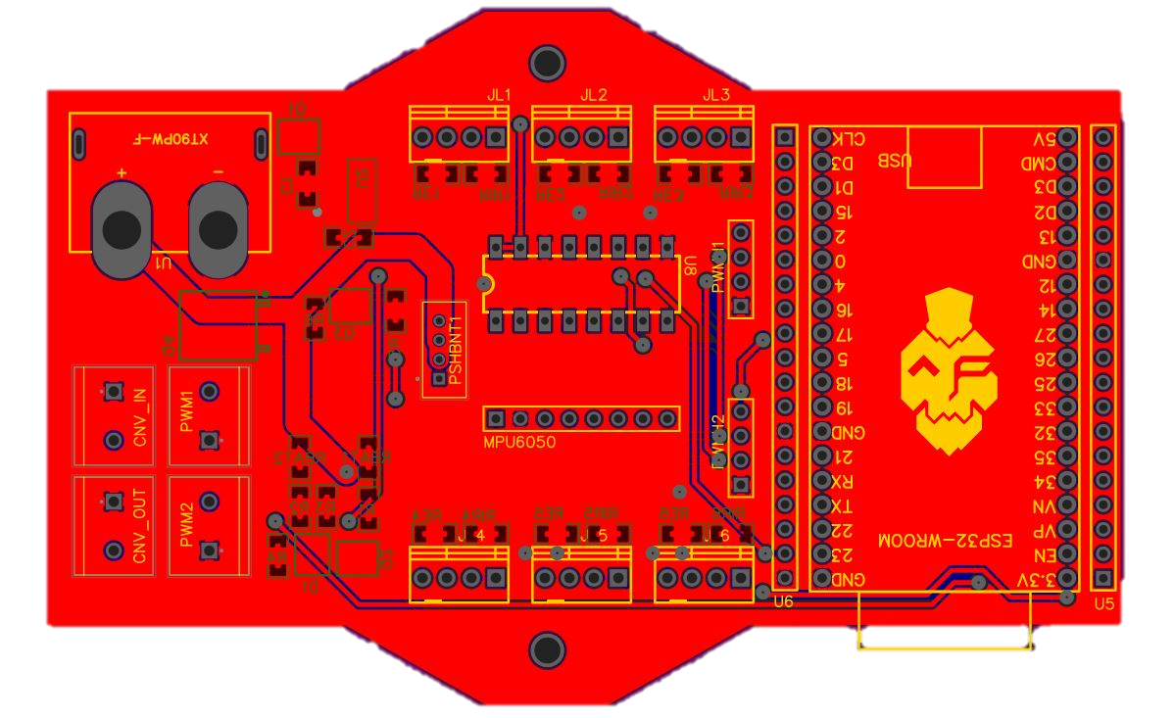
Power module
The Power Module of the motherboard takes care of the powerup and shutdown sequence of the robot, power distribution to every
part of the robot.
Schematic of the Motherboard
The motherboard of the robot consists of 3 modules:
Power module
Leg IR module
Control module
Leg IR module
An IR sensor is installed into the piston mechanism of each leg. With the help of a ADC we can if the leg is touching the
ground or not.
Control module
The Control module consists of the robot’s MCU, three axis accelerometer and gyroscope, and connectors that establishes the connection between the MCU and the external PWM modules.

Slide 10

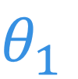


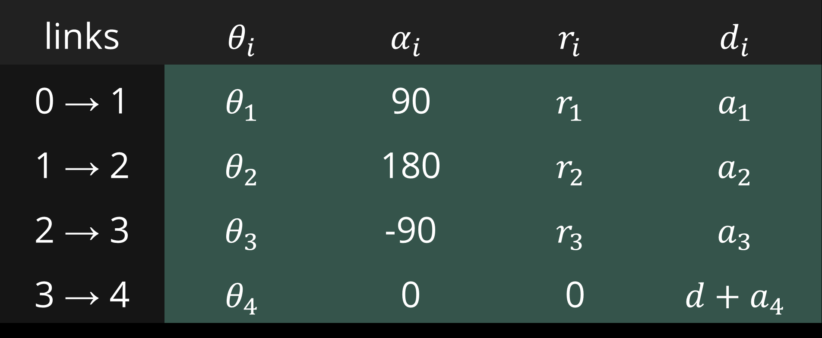
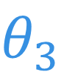

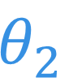

Forward and Inverse kinematics of a
leg
$$a_{3}$$
$$θ_{3}$$
$$a_{1}$$
$$d$$
$$θ_{2}$$
$$a_{2}$$
$$a_{4}$$
$$θ_{1}$$
We can describe the legs of the Hexapod as robotic manipulators, and since they are treated as manipulators, we can also draw a kinematic diagram of a leg. The servomotors and the piston mechanisms, with the spring attachments, of the robot can be treated as active joints. These two types of joints are revolute and prismatic joints.
links | $$θ_{i}$$ | $$α_{i}$$ | $$r_{i}$$ | $$d_{i}$$
0 → 1 | $$θ_{1}$$ | 90 | $$r_{1}$$ | $$a_{1}$$
1 → 2 | $$θ_{2}$$ | 180 | $$r_{2}$$ | $$a_{2}$$
2 → 3 | $$θ_{3}$$ | -90 | $$r_{3}$$ | $$a_{3}$$
3 → 4 | $$θ_{4}$$ | 0 | 0 | $$d+a_{4}$$
$$A_{i}=Trans_{z}\left(d_{i}\right)∙Rot_{z}\left(θ_{i}\right)∙Trans_{x}\left(r_{i}\right)∙Rot_{x}\left(α_{i}\right)$$

Slide 11
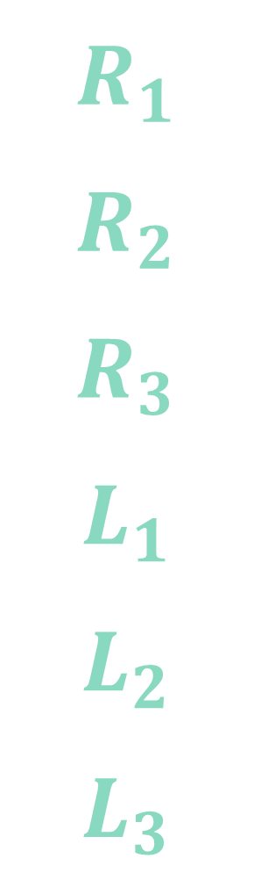
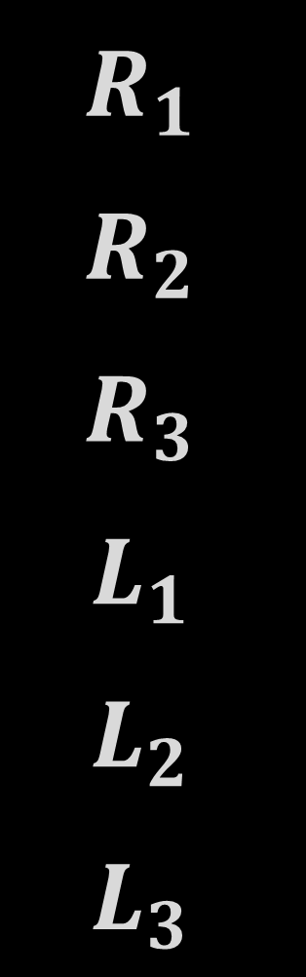
Proposed gait analysis
The legs of the Hexapod will be coded as $R_{1}$, $R_{2}$, $R_{3}$, $L_{1}$, $L_{2}$, $L_{3}$, where the notations represent the right and left legs of the robot.
Tripod gait
Metachronal gait
$$R_{1}$$
$$R_{2}$$
$$R_{3}$$
$$L_{1}$$
$$L_{2}$$
$$L_{3}$$
$$R_{1}$$
$$R_{2}$$
$$R_{3}$$
$$L_{1}$$
$$L_{2}$$
$$L_{3}$$
1 full cycle
1 full cycle

Slide 12
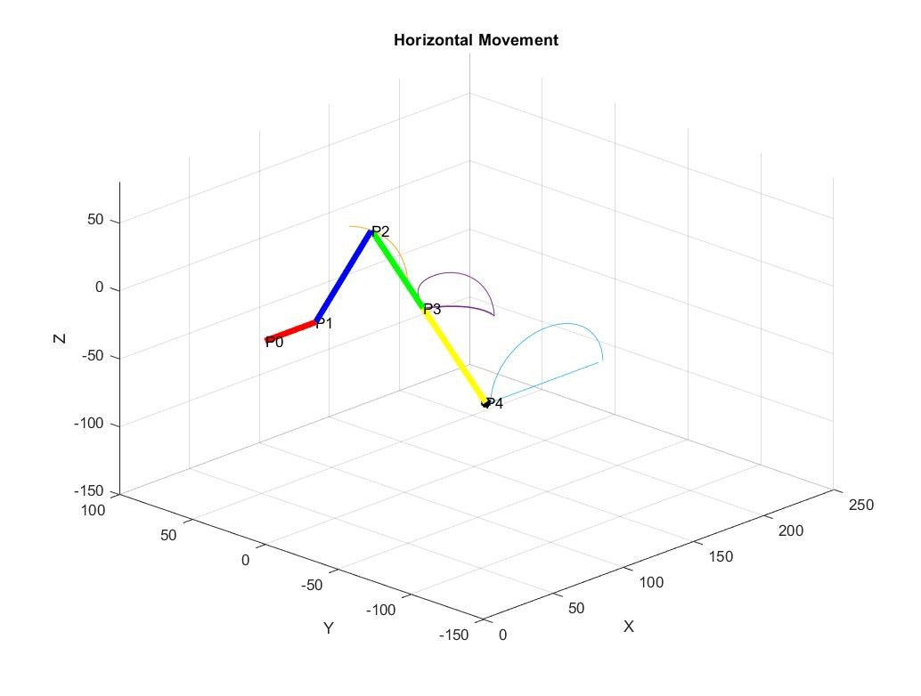
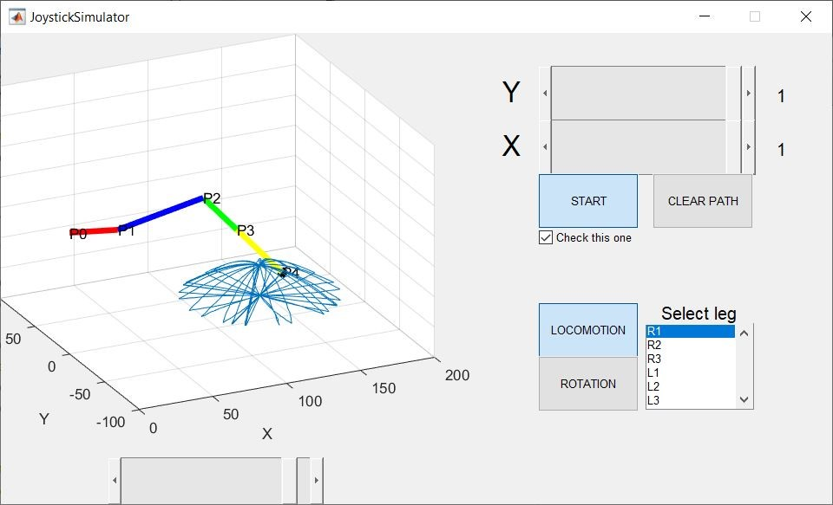
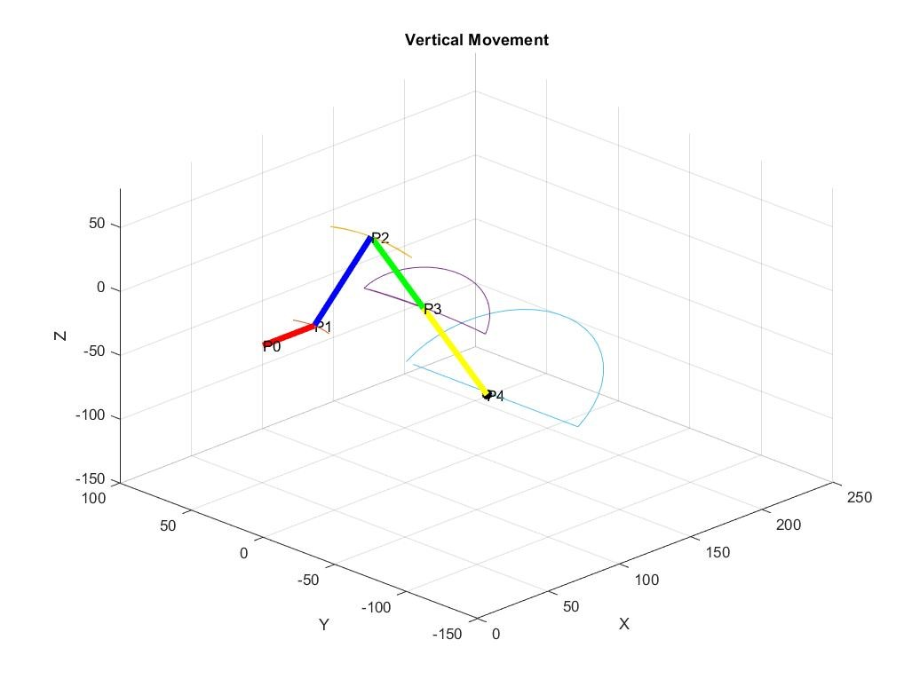
Omnidirectional movement
Implementing the gaits for the legs of the Hexapod requires a path which the endpoint of a leg is able to follow. To verify the equations for the robot’s kinematics and to test the gaits a MATLAB simulation was created to evaluate the joint movements of a leg.
Path generation for gait implementation and simulation

Slide 13
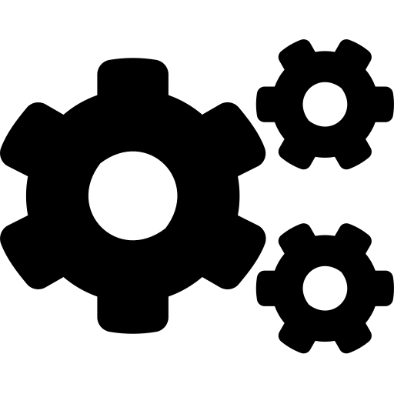

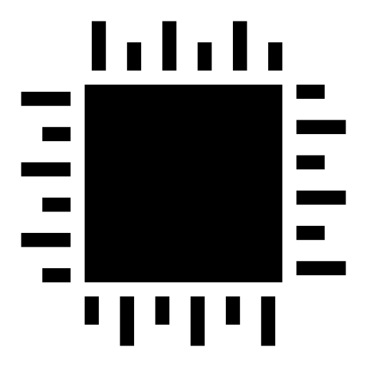



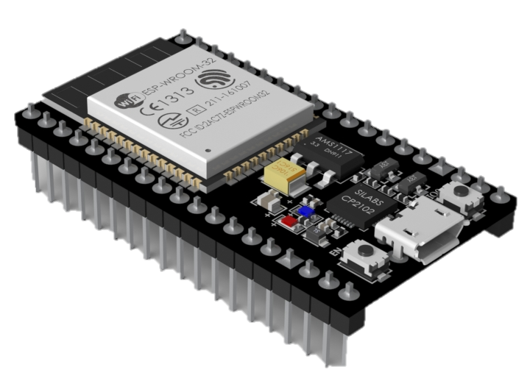
MCU firmware
The ESP32 runs MicroPython, a full Python compiler and runtime interpreter. The compiler firstly looks for the boot.py file and runs it, the main.py Python file handles the looping of the control algorithm and the MQTT client connection using the umqtt.py library. After a successful network establishment to the MQTT broker, the main program creates a Hexapod object from the class with the same name. The hexapod.py library also makes use of the pca9685.py library with which the MCU establishes I2C communication with the PWM driver board.
core 0
MQTT client
core 1
control algo.

Slide 14
MQTT network
Published message
In this configuration, the MCU firmware and the Android application act as clients that subscribe/publish messages to the broker. The Mosquitto broker is a piece of software that runs on a remote server, its job is to receive the published messages, save these messages to their respective topics and then transmit the messages to the clients that were subscribed to these topics
Subscription message
Published message

Slide 15
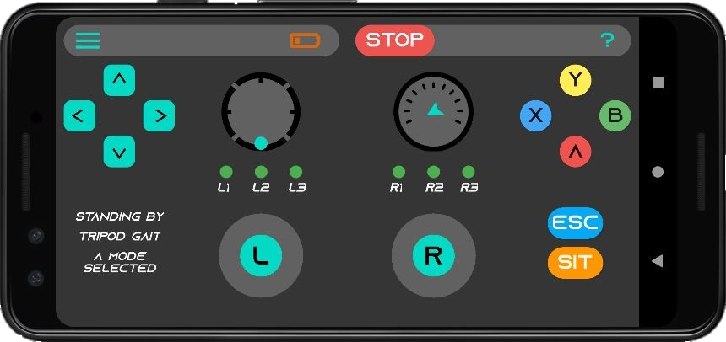
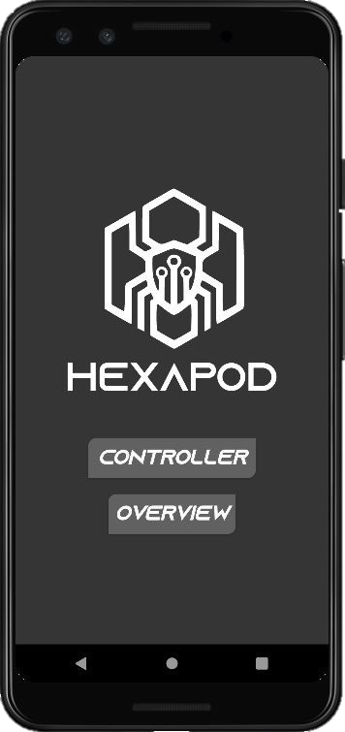
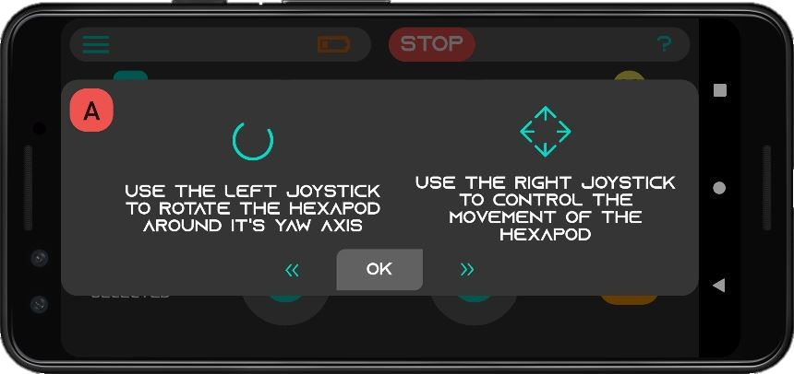
Android application
Opening the Hexapod Controller app, the user is taken to the menu of the application. touching the “Controller” button opens up the actually controller activity
Because the controller might be a bit confusing at first, touching the “?” found at the upper right corner of the controller, opens up a dialog where a detailed description of the controller’s functionality and the robot’s sensors are explained.

Slide 16
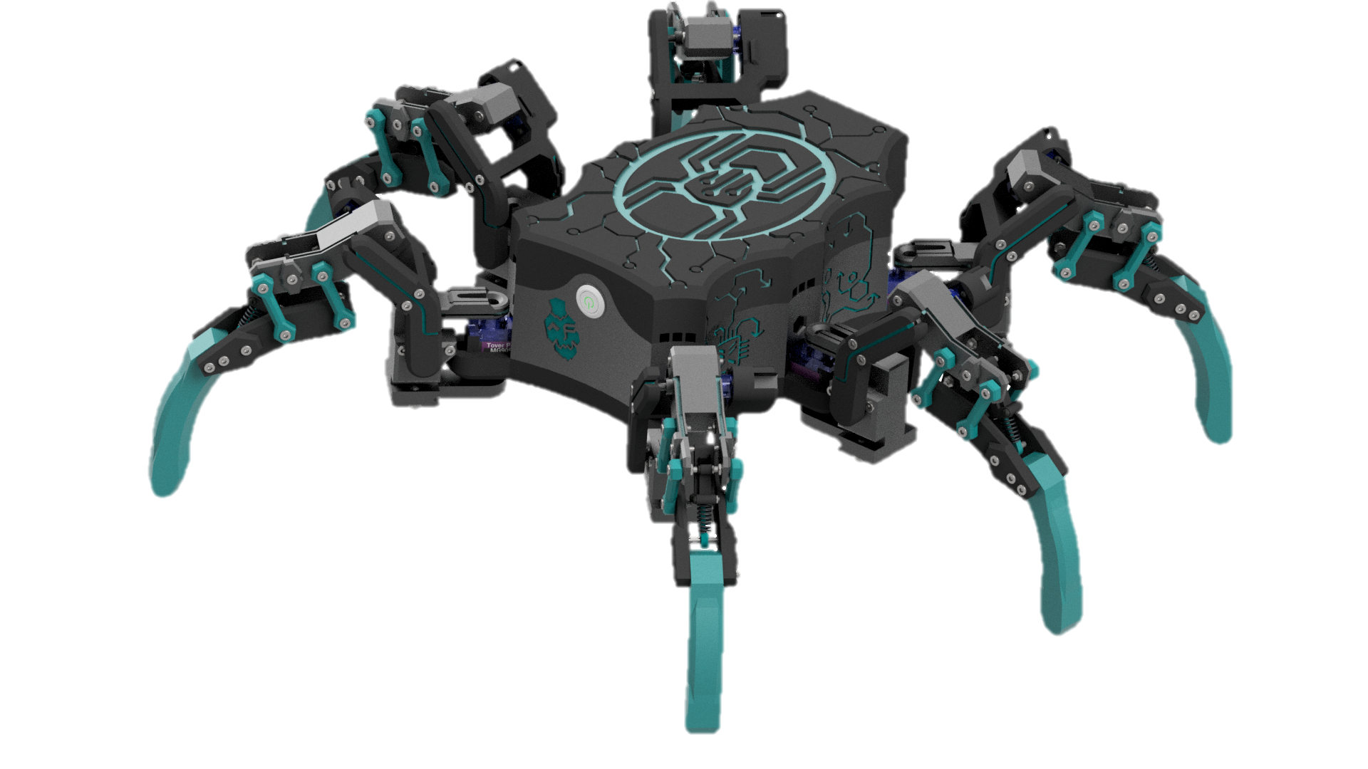
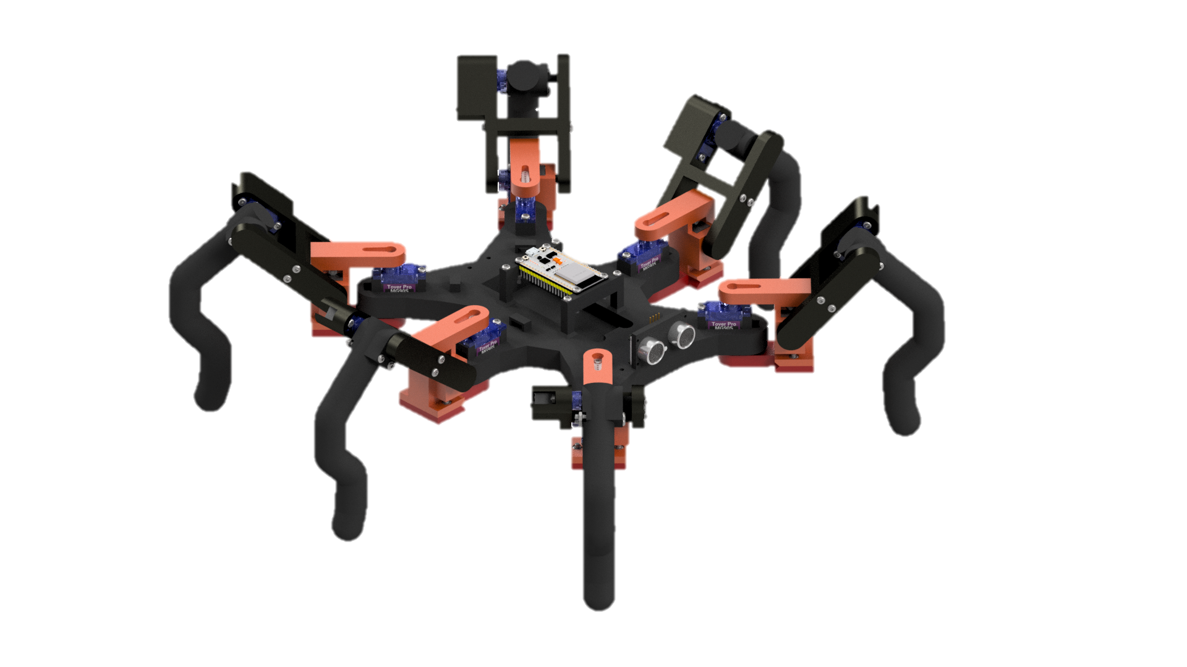
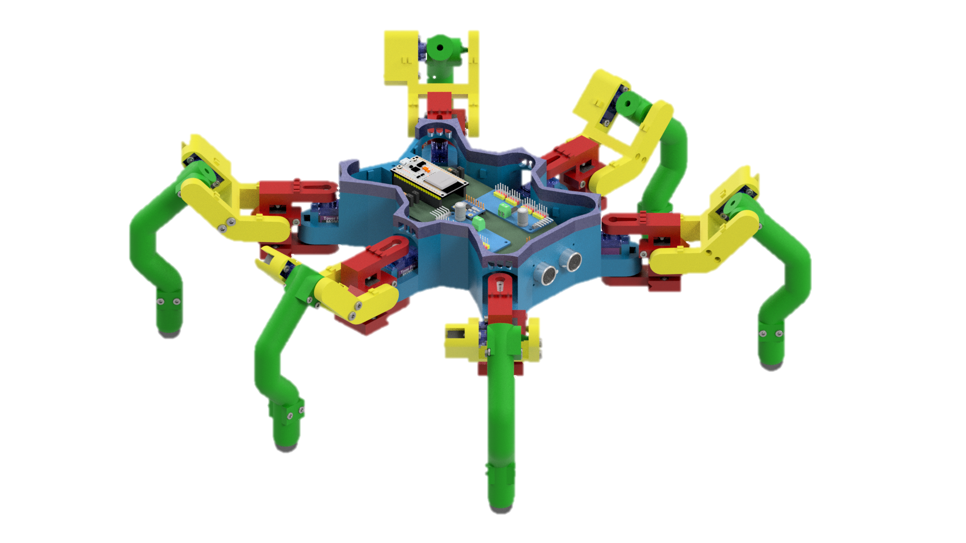

version .x
4
3
2
1
Current model
Working hardware plan
MCU programmed in MicroPython
Telescopic leg design
Full protective shell
First attempt
No hardware plan
MCU programmed in Arduino framework
Rigid legs
No protective shell
Minor modifications for leg design
First motherboard schematic
Added PWM drivers
Pushbuttons installed in every leg
First attempt at a shell
Remodel body
New hardware plan
Larger/stronger servos for mobility and agility
CAM + LiDAR for environment imaging
Hand-held controller (RC)

Slide 17
Bibliography
Tedeschi, Franco, and Giuseppe Carbone. 2014. "Design Issues for Hexapod Walking Robots" Robotics 3, no. 2: 181-206. https://doi.org/10.3390/robotics3020181
Denavit, J., & Hartenberg, R. (1955). A Kinematic Notation for Lower-Pair Mechanisms Based on Matrices. Journal Of Applied Mechanics, 22(2), 215-221. doi: 10.1115/1.4011045
Fujiki, S., Aoi, S., Funato, T., Tomita, N., Senda, K., & Tsuchiya, K. (2013). Hysteresis in the metachronal-tripod gait transition of insects: a modeling study. Physical review. E, Statistical, nonlinear, and soft matter physics, 88 1, 012717
Ramdya, P., Thandiackal, R., Cherney, R. et al. Climbing favours the tripod gait over alternative faster insect gaits. Nat Commun 8, 14494 (2017). https://doi.org/10.1038/ncomms14494
Acknowledgements
I would like to express my special appreciation and thanks to my advisors Dr. Szántó Zoltán and drd. Fehér Áron.

Slide 18
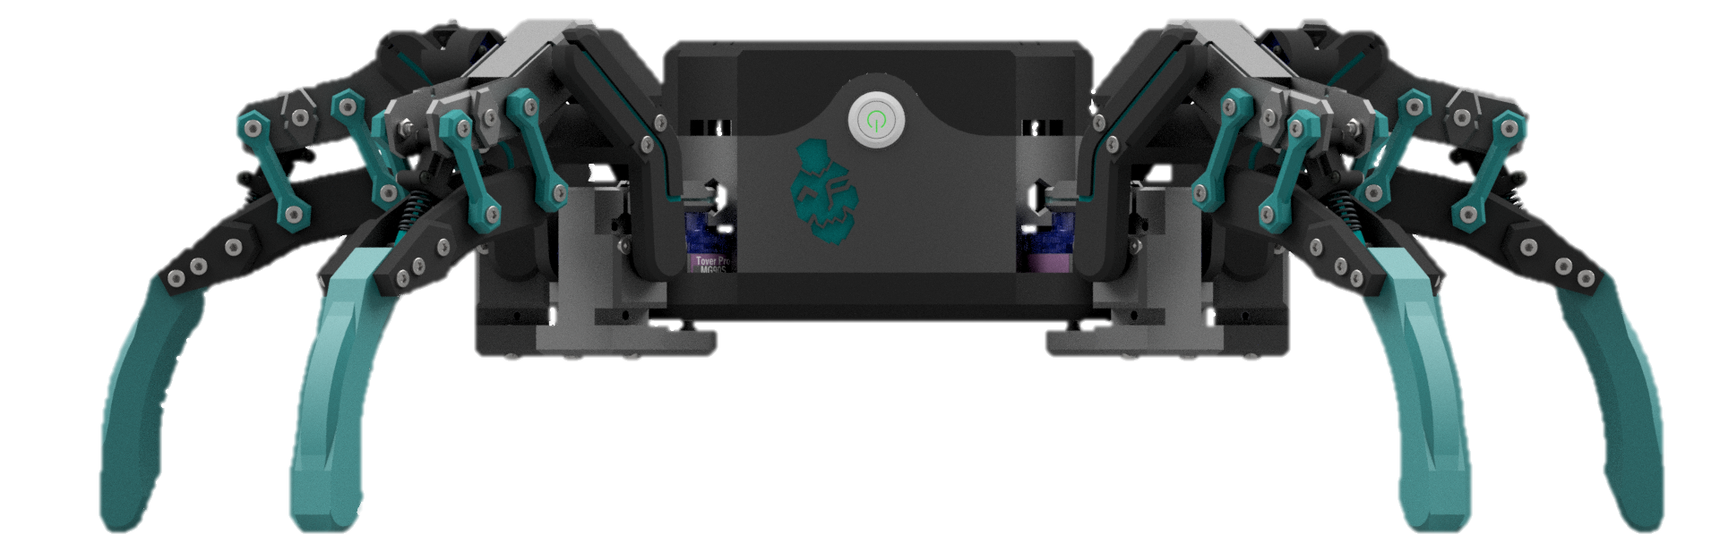
Thank you for your attention.
Github: github.com/cybdann/Hexapod

